Slide 1
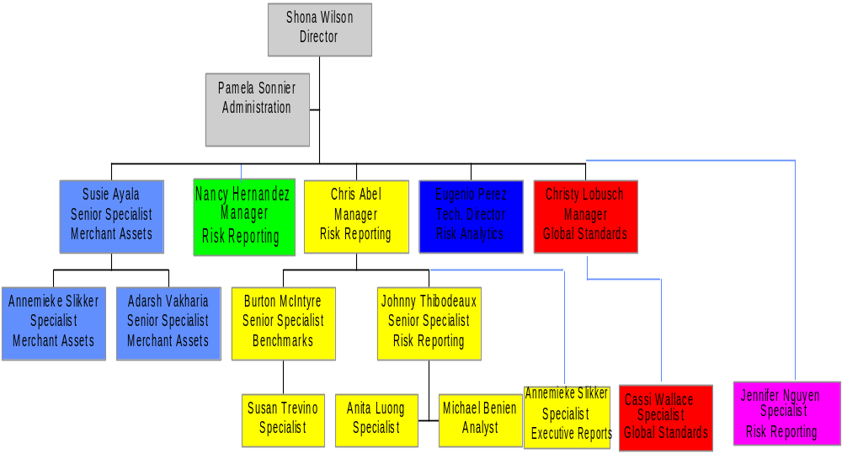
Global Risk Operations

Slide 2
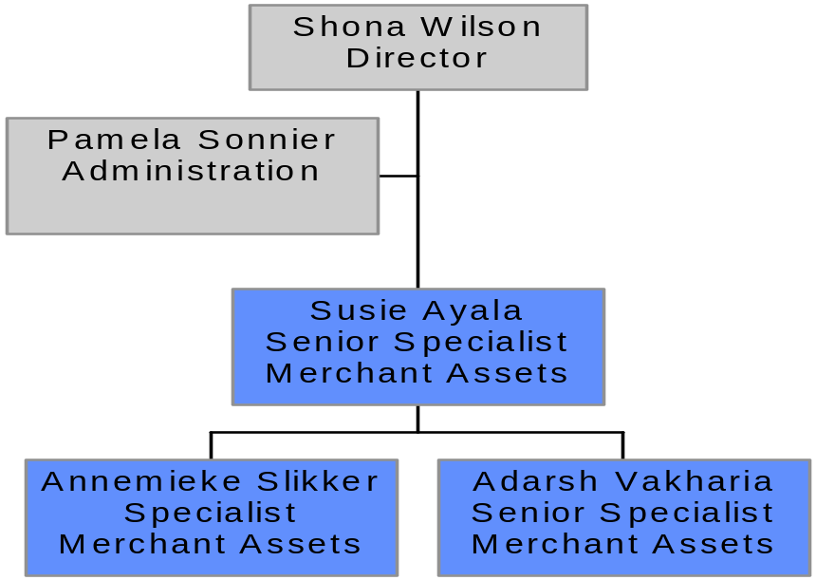
Merchant Assets
Responsibilities
Daily risk reporting for merchant assets
SEC VAR

Slide 3
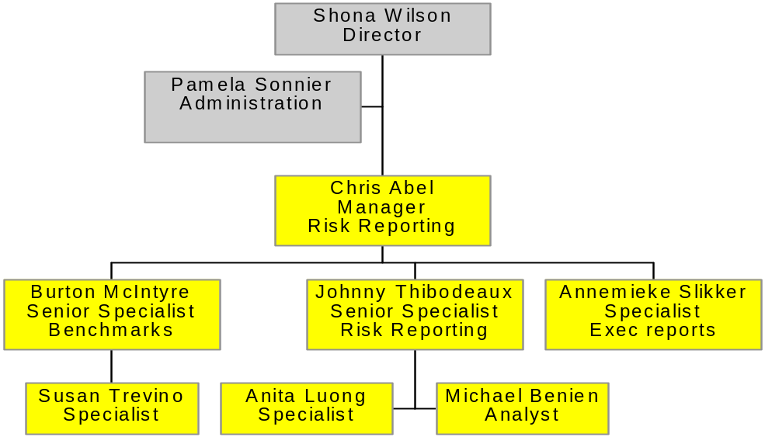
Global Risk Operations
Responsibilities
Daily position report
Daily benchmarks
Daily violation memorandums
Executive report viewer
Liason with accounting
Running IR/FX VAR

Slide 4
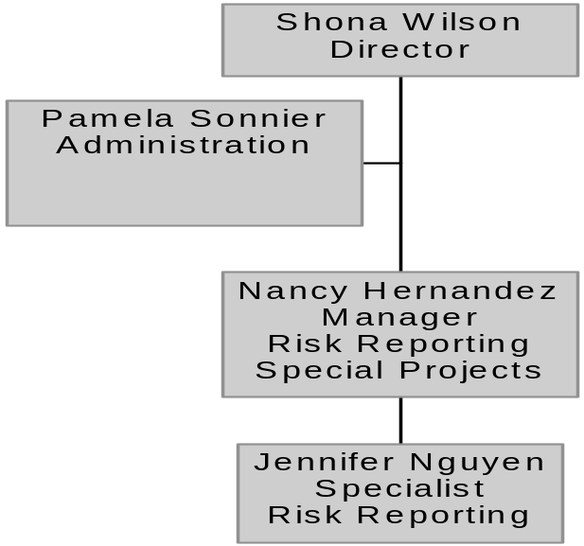
Global Risk Operations
Responsibilities
Special projects & establishing processes and controls around RisktRAC
  Lombard
  books
Liason with risk reporting group re RisktRAC (resolution of daily risk reporting issues)

Slide 5
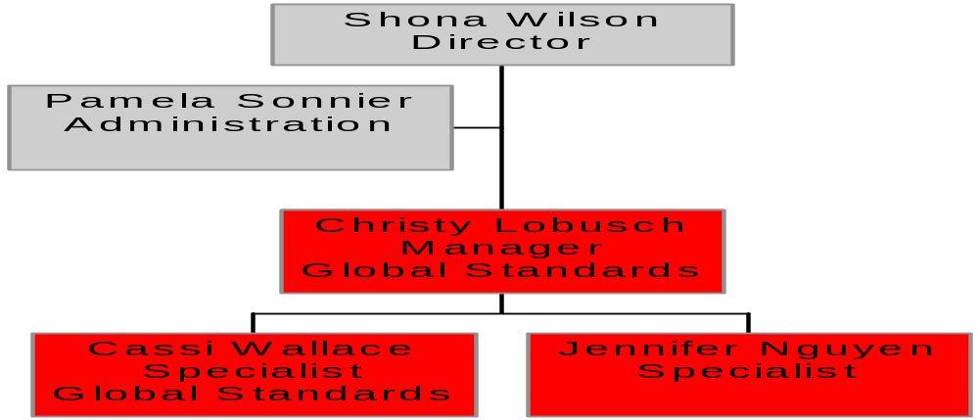
Global Risk Operations
Responsibilities
Daily exception reporting
Following up on exceptions - ensuring processes and controls are improved
Doorstep administration
Tracking of trading offices
Curve validation

Slide 6
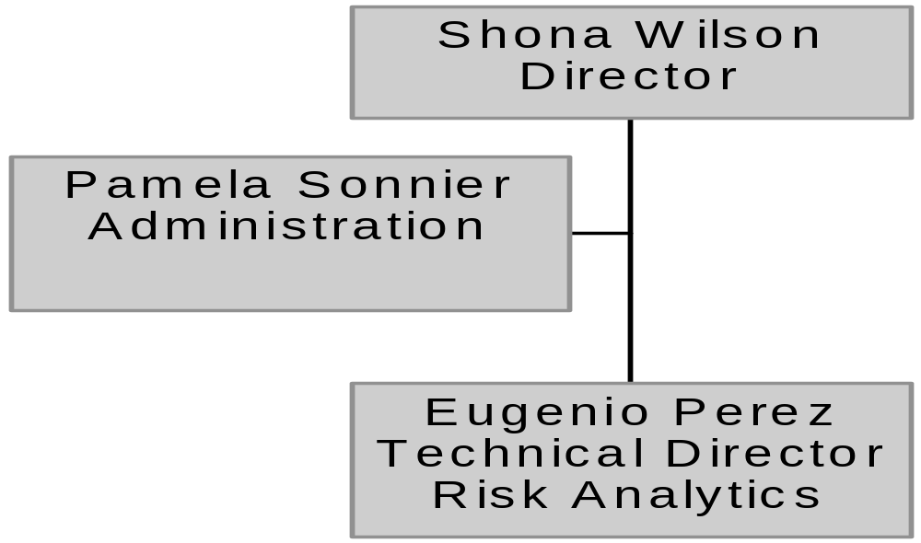
Global Risk Operations
Responsibilities
ATHENA (support, training, installation, documentation of system)
Development projects

